Slide 1



Project 19063
Epileptic Seizure Detection and Notification System
Team Members:
Alejandro Ortega Biomedical Engineering
Gordon Downs Electrical and Computer Engineering
K. Humberto López Félix Biosystems Engineering
Louie Bertani Industrial Engineering

Slide 2

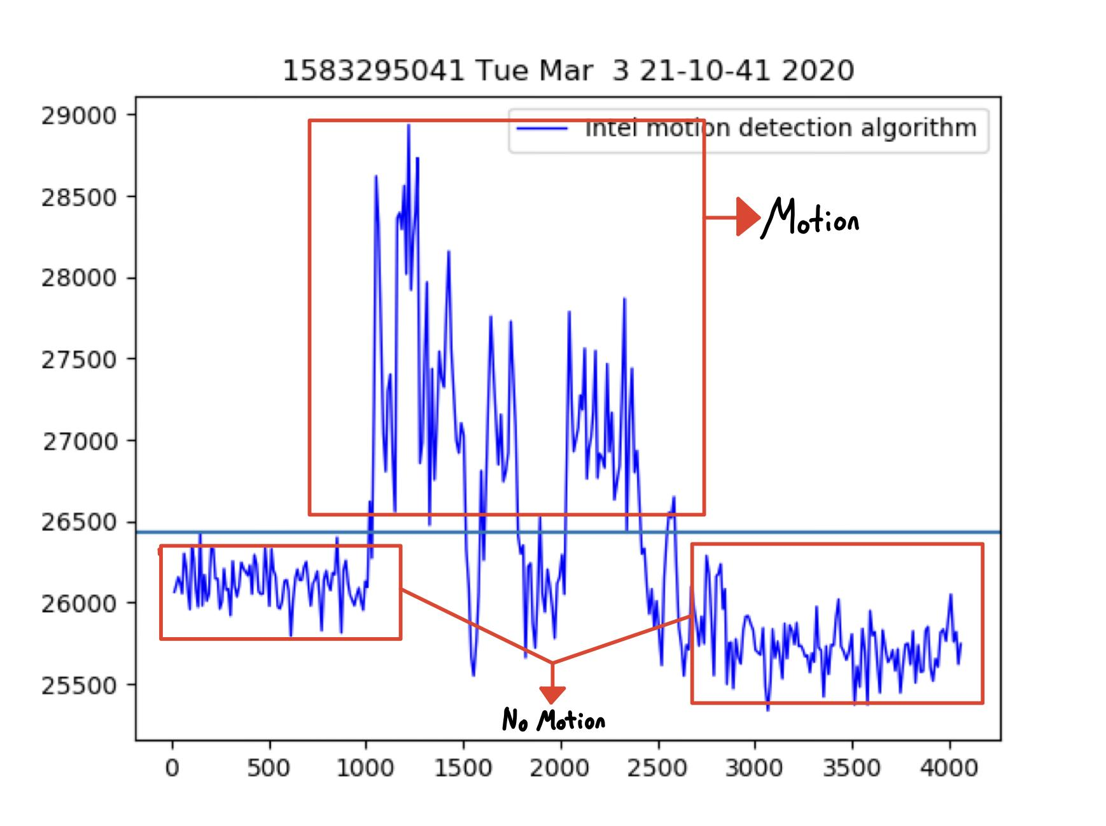
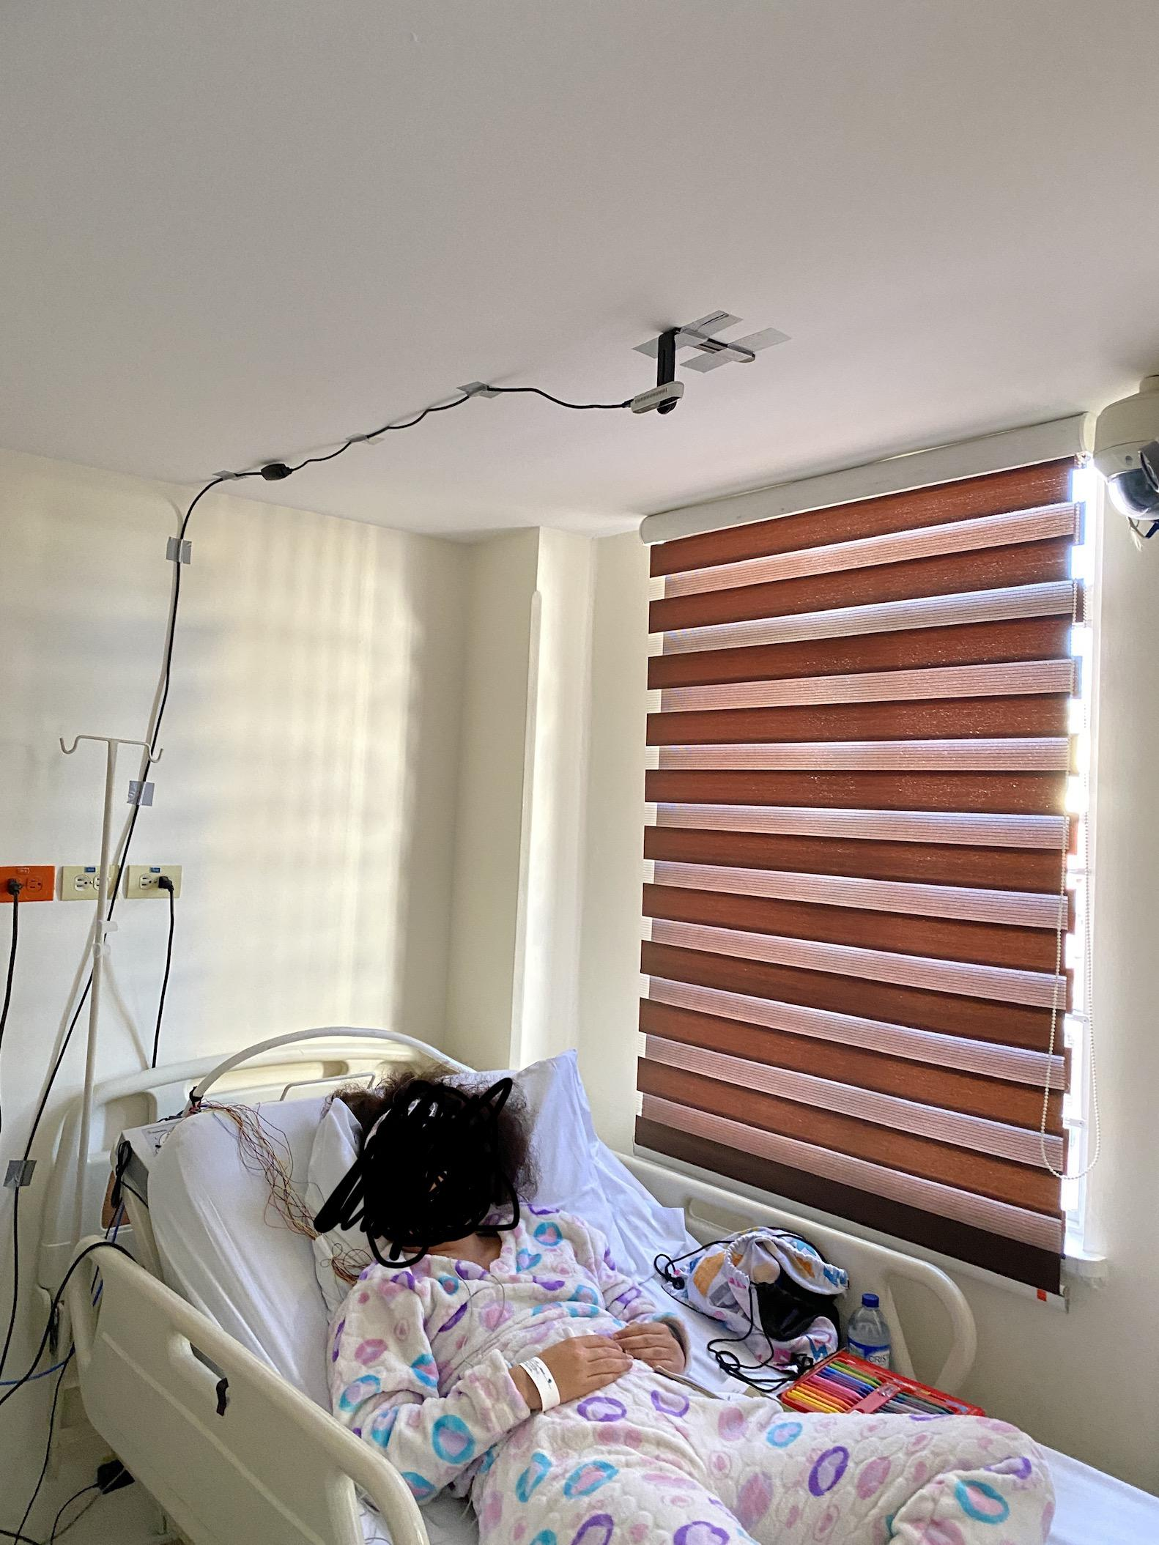
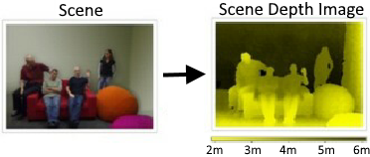

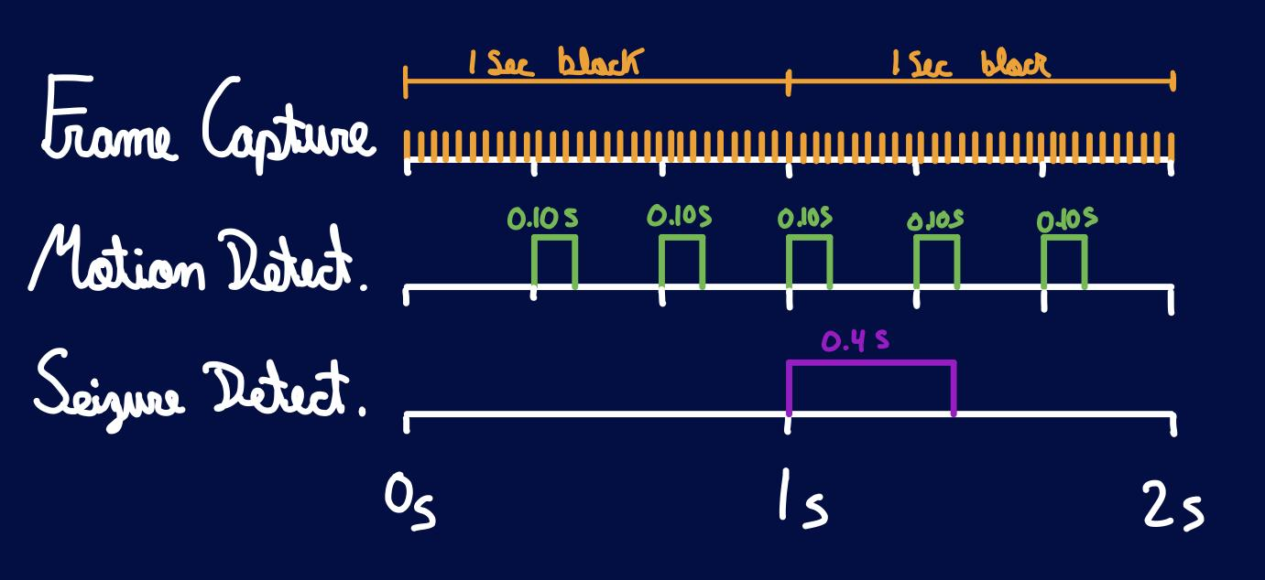
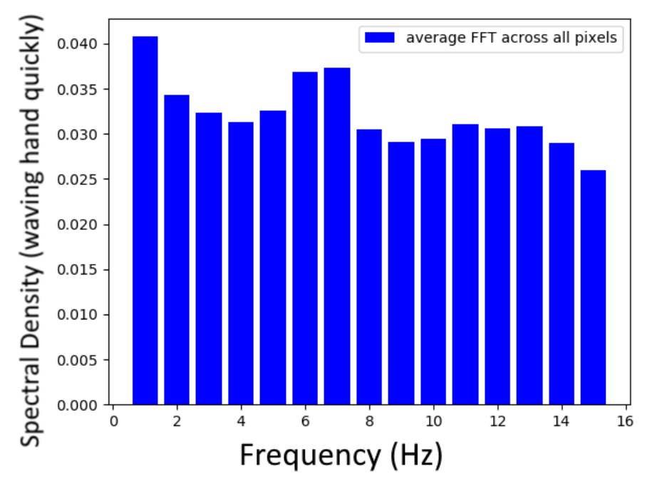
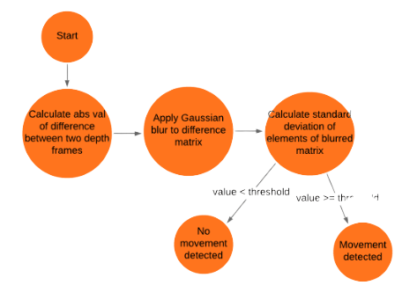
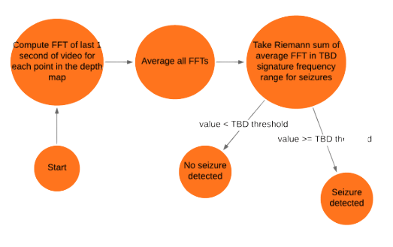
Team 19063
Epileptic Sleep Seizure Detection and Notification System
Introduction &
Problem Description
Sudden Unexpected Death in Epilepsy (SUDEP) can occur during seizures, and is most likely to occur when a patient is sleeping alone.
SUDEP may be prevented by helping the patient during seizure events.
Want a system that detects seizures and quickly notifies caregivers.
Devices currently available on the market are very expensive and have poor accuracy.
Results
Motion detection algorithm customized for the D415 showed 100% accuracy in our tests.
MVP Data Collection System was deployed in Colombian clinics for data collection, but trials were cancelled due to COVID-19
Motion and Seizure Detection algorithms were optimized to run in real time with our hardware
Characteristic frequencies of motion are observed after post processing making data feedable to AI classifiers
Conclusions
We designed a system that monitors epileptic patients overnight and notifies caregivers when seizures occur.
Given the circumstances of COVID-19 and 2 team members leaving the team, we could not gather training data for our seizure detection algorithm.
Our rescope enables the open source community to contribute data that is ready to be used for training the AI classifiers, and our spectral analysis method ensures privacy for users submitting data.
We added longevity to the project through documentation and open source licence BSD+Patent
Key Equipment
Intel RealSense D415 IR depth camera
Mini PC for data processing
References
Joo, Hyo Sung et al., “Spectral Analysis of Acceleration Data for Detection of Generalized Tonic-Clonic Seizures.” Sensors (Basel, Switzerland) vol. 17,3 481. 28 Feb. 2017, doi:10.3390/s17030481
Key Algorithms
State-of-the-art motion detection algorithm
Seizure detection algorithm: spectral analysis via discrete Fourier transform
Acknowledgements
Sponsor: Iwan Grau & Palanivel Guruvareddiar (Intel Corporation)
Mentor: Catherine Merrill
Team Members: Gordon Downs, Alejandro Ortega, Louis Bertani, Humberto Lopez

Slide 3
Backup slides

Slide 4
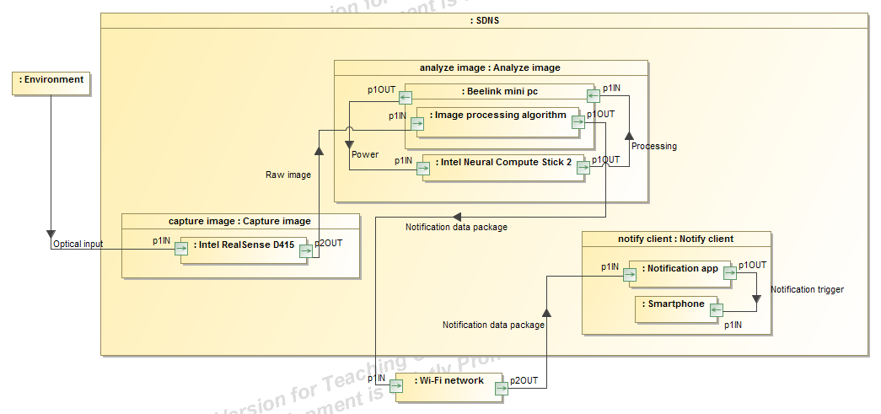
1.2 System Block Diagram
We understand the interaction between the different components of the SDNS.
Notes:
The idea here is to remind the panel of the multiple subsystems and components that are present in our SDNS. Explain if anything changed (which I believe in terms of the block diagram we have not changed anything, maybe include the server we want to set up for notifications over the internet)

Slide 5
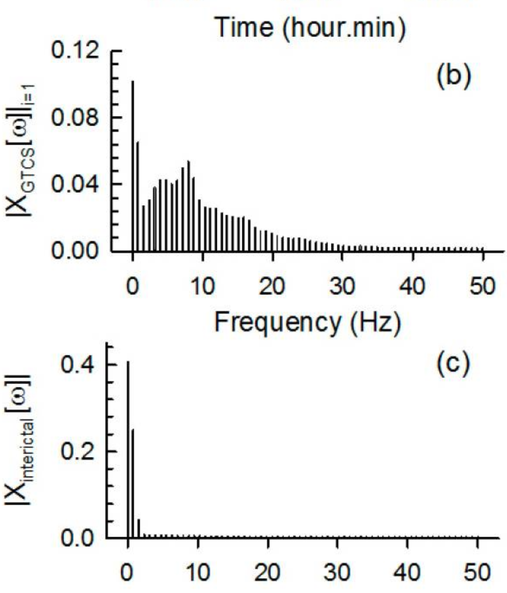
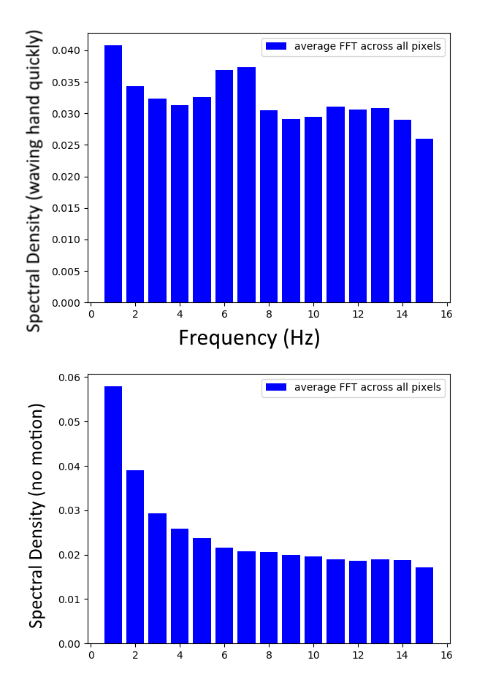

Slide 6
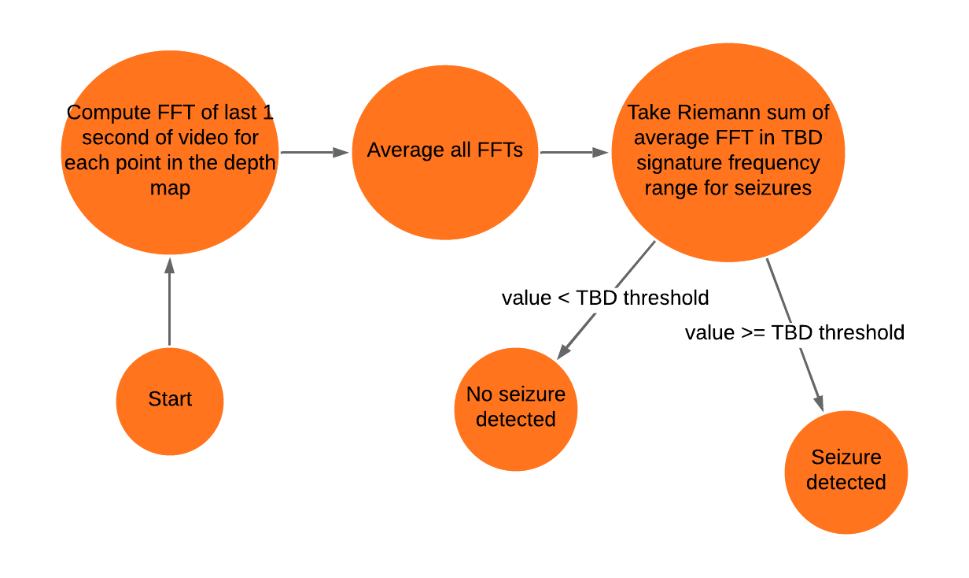
Seizure Detection Algorithm

Slide 7
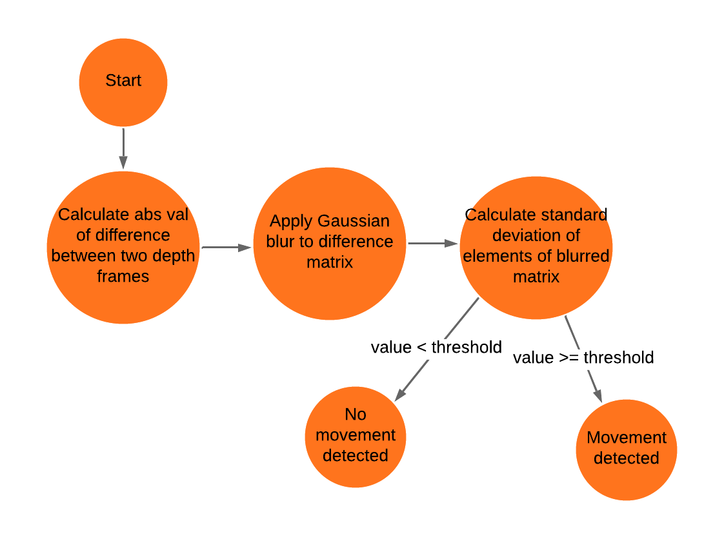
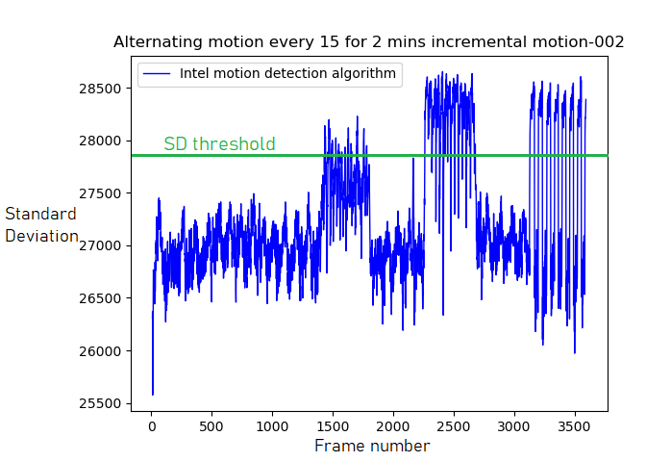
Motion Detection Algorithm

Slide 8
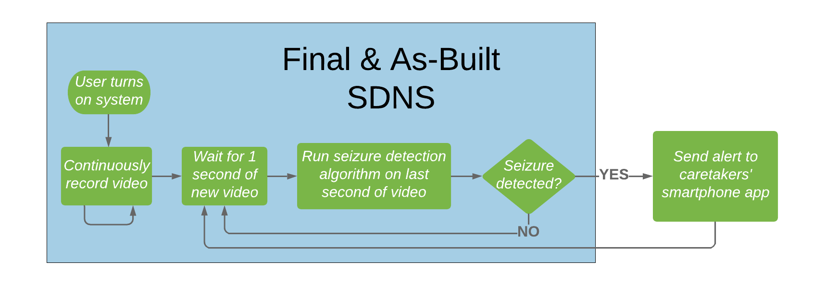
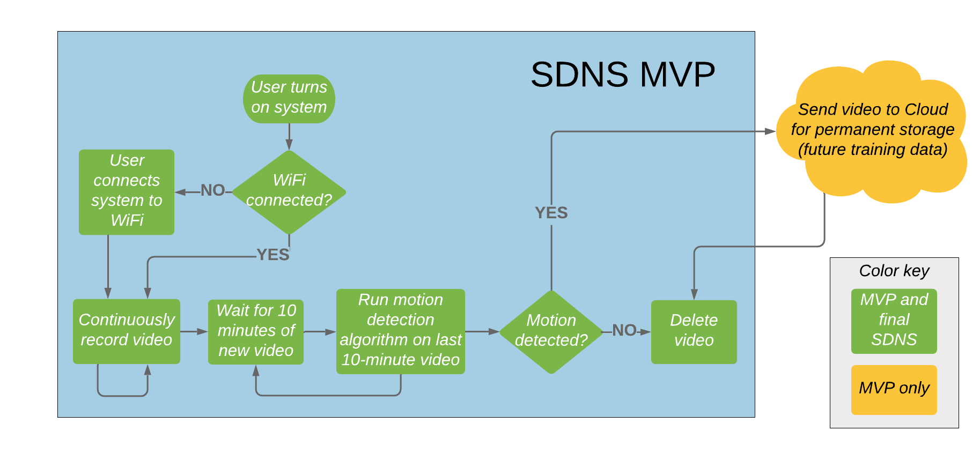
Software diagrams

Slide 9

MVP vs Final System
MVP Final (as-built) system
Same
hardware setup
Both have realtime
functionality
on Mini PC
Performs
data collection
Motion detection
algorithm used
5 systems set up
(3 in Colombian
hospital, 2 in USA)
Performs
seizure detection
Seizure detection
algorithm used
(spectral analysis)

Slide 10
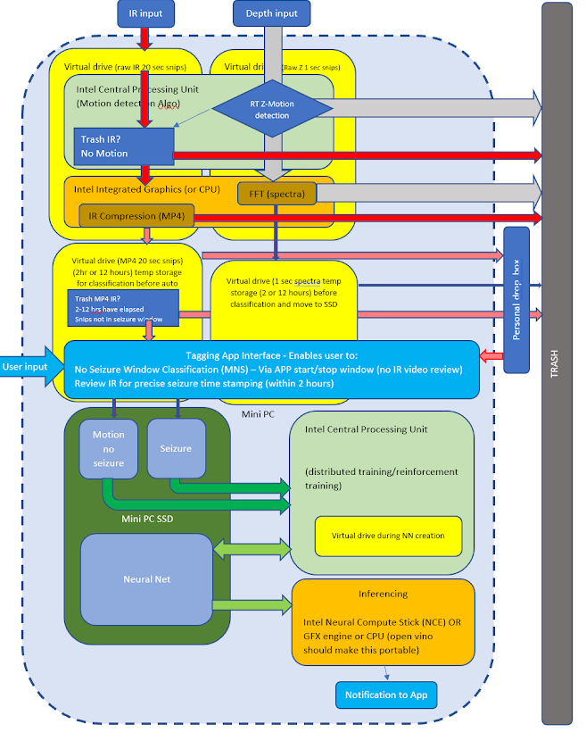
Proposed Rescope

Slide 11
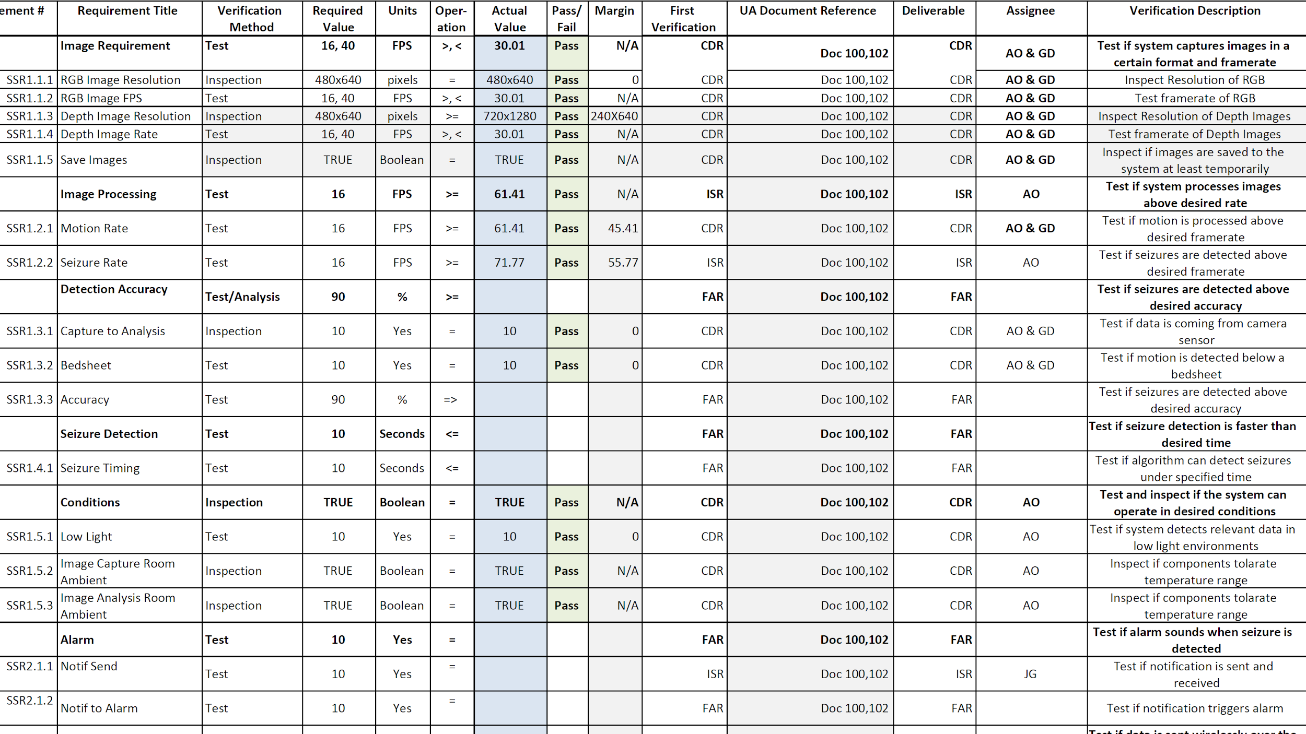
SRVM

Slide 12
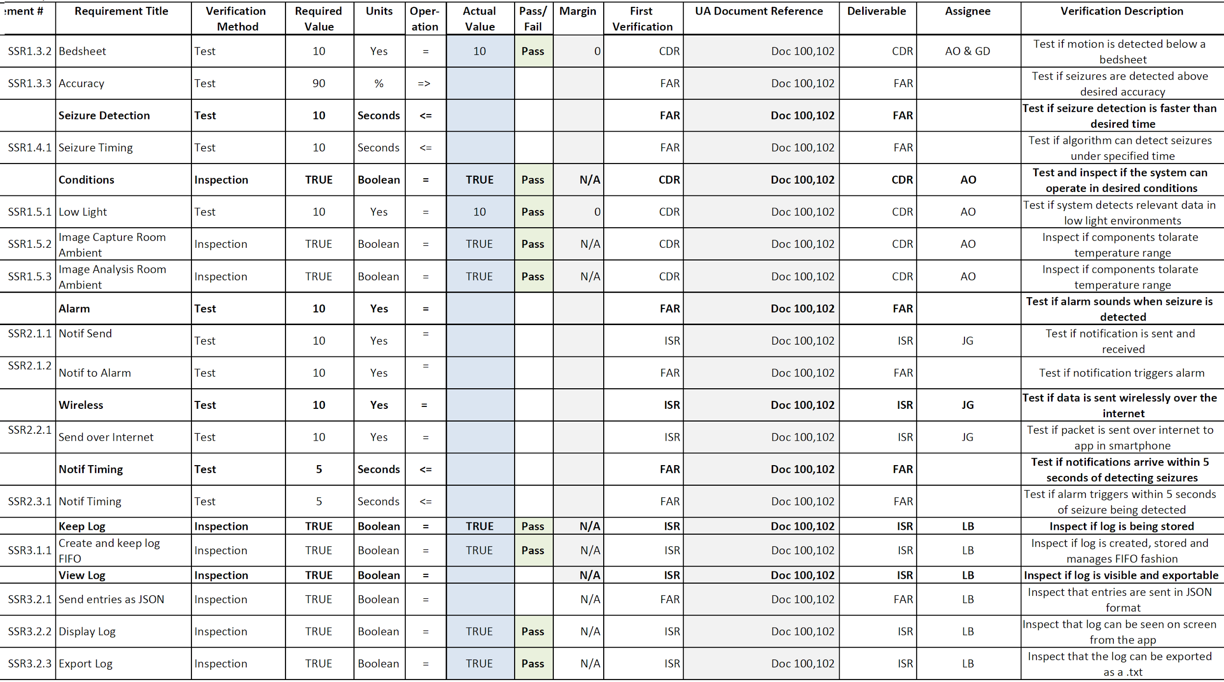
SRVM

Slide 13
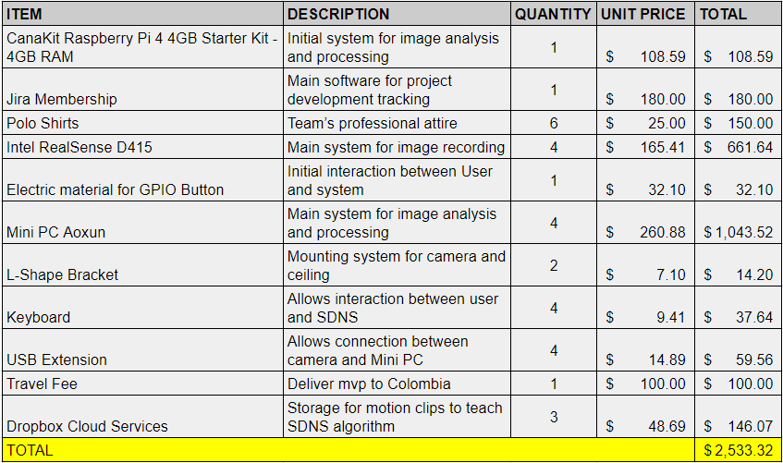
Cost
We can complete the project based on our Cost Analysis for FAR
Notes:
Goal is to explain why we can complete the project in terms of cost

Slide 14
Lessons Learned
“Simple is better than convoluted”
“Documentation is as important as implementation”
“As an engineer, I learned that the team’s harmony is very important to have a successful project. If harmony is not present, it can lead to mistrust and and problems could arise within the team.”
“Building early is key to identify strengths and flaws of the design”
“The last 10% is harder than the other 90%”
“Cost-effective pushes engineers to look for creative and simple products, which allows more testing and clinical trials.”

